Slide 1


CRIME DATA ANALYSIS
Presented by : Ansh Goyal & Kartik Jindal

Slide 2


introduction
Crime analysis helps police examine crime patterns and case details.
Traditional systems use paper records → slow, inefficient.
This project creates a digital system to manage crime cases efficiently using:
Python + Flask + MySQL + HTML/CSS

Slide 3

Objective of the Project
To design a relational database for crime data.
To implement CRUD operations.
To use joins, views, and triggers in SQL.
To build a GUI for easy case management.
To store and analyze cases, locations, officers, and crime types.

Slide 4

Technologies Used
Frontend
HTML
CSS
Bootstrap
Backend
Python (Flask Framework)
Database
MySQL
SQL Queries, Views, Triggers

Slide 5
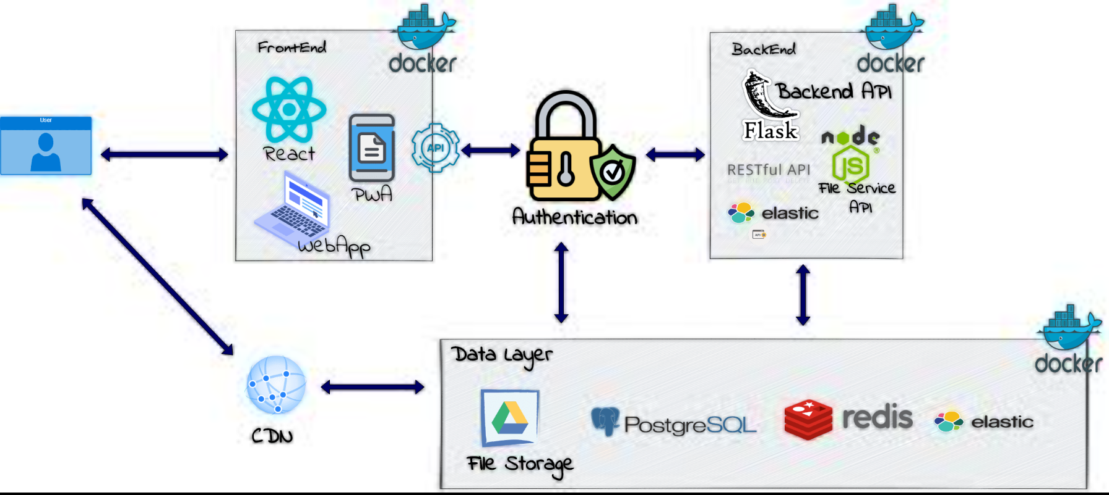
System Architecture

Slide 6
Database Design
Tables:
crime_case
location
officer
crime_type
Relationships:
Case → Type (Many to One)
Case → Officer (Many to One)
Case → Location (Many to One)

Slide 7

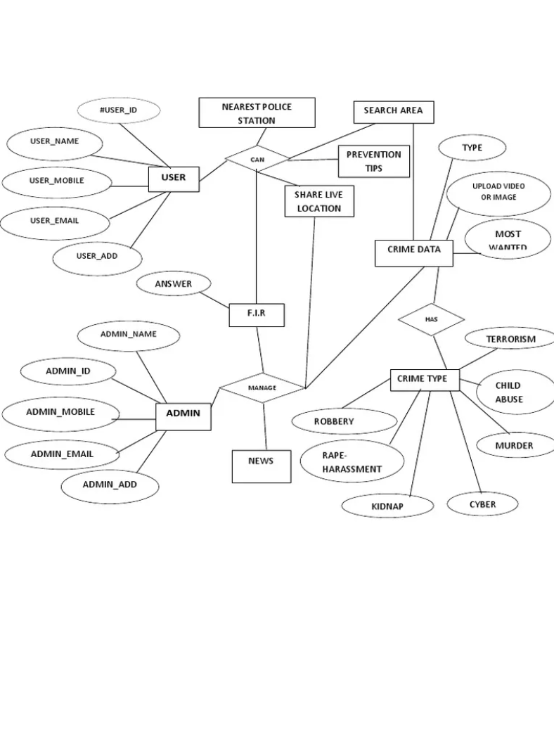
Relationships:
Case belongs to one Officer
Case linked to one Location
Case linked to one Crime Type
ER Diagram
Entities:
Crime Case
Officer
Location
Crime Type

Slide 8
Important SQL Queries
Join Query:
SELECT c.case_code, t.type_name, o.officer_name
FROM crime_case c
JOIN crime_type t ON c.type_id = t.type_id
JOIN officer o ON c.officer_id = o.officer_id;
View:
CREATE VIEW open_cases AS SELECT * FROM crime_case WHERE status='Open';
Trigger:
CREATE TRIGGER log_case_insert
AFTER INSERT ON crime_case
FOR EACH ROW
INSERT INTO case_log(action, case_code)
VALUES ("New Case Added", NEW.case_code);

Slide 9
GUI Features
Add new crime case
Enter manual location and officer
View case details
Close/delete case
Dashboard counters (Open/Closed/Total cases)
Responsive interface using Bootstrap

Slide 10
Working of the System
Steps:
User opens system
Adds a new case
Flask sends data to MySQL
Case appears in updated table
User can view/close/delete
Stats update automatically

Slide 11
Conclusion
Project demonstrates DBMS concepts effectively
Easy-to-use interface for managing crime records
Implements SQL Join, Views, Trigger
Can be improved further with login, analytics, maps

Slide 12
Future Scope
Add admin login
Add predictive crime analytics
Add charts and data visualization
Add heat map for crime hotspots

Slide 13

thank you

